Slide 1
Employee Data Analysis using Excel
Student name: S.priyanka
Register no: 422200251
Department: b.com ism
College: Annai violet arts and science college

Slide 2
Employee Performance Analysis using Excel
Excel can be used to analyze employee performance in a number of ways, including:
Performance review templates
Excel templates are a common method for performance reviews and can be customized to a company's needs. They can be used to track and compare employee performance over time, by department, category, month, or employee.

Slide 3


AGENDA
Problem Statement
Project Overview
End Users
Our Solution and Proposition
Dataset Description
Modelling Approach
Results and Discussion
Conclusion
3/21/2024 Annual Review

Slide 4

PROBLEM STATEMENT
A problem statement is a description of an issue to be addressed, or a condition to be improved upon. It identifies the gap between the current problem and goal. The first condition of solving a problem is understanding the problem, which can be done by way of a problem statement.[1]

Slide 5

PROJECT OVERVIEW
All
Images
Videos
News
Shopping
Web
Books
Maps
Short videos
Flights
Finance
Search tools
Feedback
தமிழில் தேடுங்கள்
திட்ட கண்ணோட்டம்
AI Overview
+2
A project overview is a concise document that summarizes the key details of a project, including the goals, timeline, budget, and resources. It's a reference for team members and stakeholders, and is often created at the beginning of a project.
A project overview can help:
Define the project: Outline the project's scope, boundaries, and limitations
Provide a framework: Establish the basis for the project's length
Simplify complex information: Present large amounts of data in a way that's easy to understand
Prepare for the project: Ensure that everyone has a clear idea of what needs to be done, when, and who's responsible
A project overview typically includes:
The project's goals and objectives
The steps to achieve the goals
The expected outcomes
The project's timeline
The project's budget
The resources required
The project's status
Potential risks
A project overview is usually created by a project manager or department manager. It's often included at the beginning of a project proposal, which contains more detailed documents on the project's schedule and budget.
A project overview is a concise document that summarizes the key details of a project, including the goals, timeline, budget, and resources. It's a reference for team members and stakeholders, and is often created at the beginning of a project.

Slide 6

WHO ARE THE END USERS?
Management and excuses
Employee
Team leader

Slide 7

OUR SOLUTION AND ITS VALUE PROPOSITION
value proposition is a statement that explains why a customer should choose your solution over a competitor's. It's a promise to customers that summarizes the unique value of your product or service and the benefits it offers. A good value proposition should be clear, straightforward, and compelling. It should also demonstrate how your solution fills a customer need and how it's better than similar products.

Slide 8
Dataset Description
A dataset is a structured collection of data that is organized and stored for processing or analysis. Datasets can be made up of many different types of data, including: Numerical values, Text, Images, Audio recordings, and Basic descriptions of objects. Datasets can be used for many purposes, including: Training and testing machine learning models, Data visualization, Research, and Statistical analysis.

Slide 9

THE "WOW" IN OUR SOLUTION
There are multiple matches for "the wow in our solution", including a way of working (WoW) framework, a live video support solution, and a design thinking concept:
Way of Working (WoW)
A framework that helps businesses improve productivity, streamline operations, and reduce waste. WoW practices can help businesses foster a culture of continuous improvement by:
3/21/2024 Annual Review
9

Slide 10
MODELLING
Modeling involves making a representation of something. Creating a tiny, functioning volcano is an example of modeling. Teachers use modeling when they have a class election that represents a larger one, like a presidential election. Modeling is anything that represents something else, usually on a smaller scale.
10

Slide 11
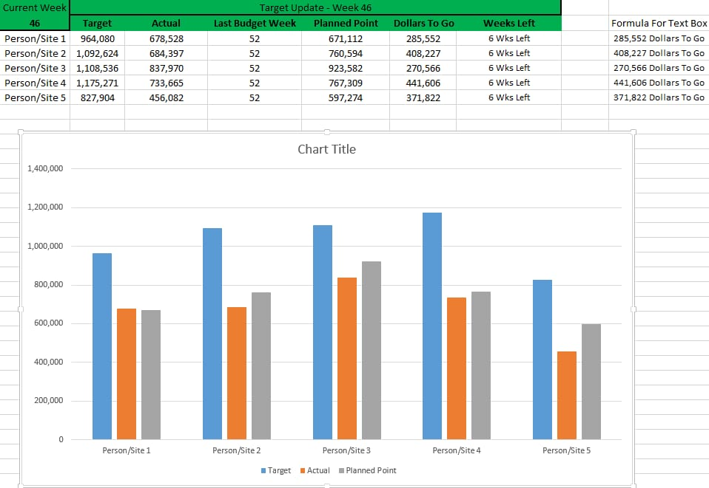
RESULTS
11

Slide 12
conclusion
Conclusion. This article highlights Excel's remarkable versatility and utility as a project management tool. From its familiar interface and cost-effectiveness to its advanced data analysis capabilities and robust reporting features, Excel stands out as a comprehensive solution for various project needs.

